Slide 1
Kelompok 2 HENDRA SETIADINATA 1701498465 SHAN MARKUS SUSANTO 1701498326 YUSRIL EKA MAHENDRA 1701498452 DWYKIE ALEXANDRA 1701498862
Service oriented architecture

Slide 2
POMONA
Available on Google Play and Apps Store
Please Rate 5

Slide 3
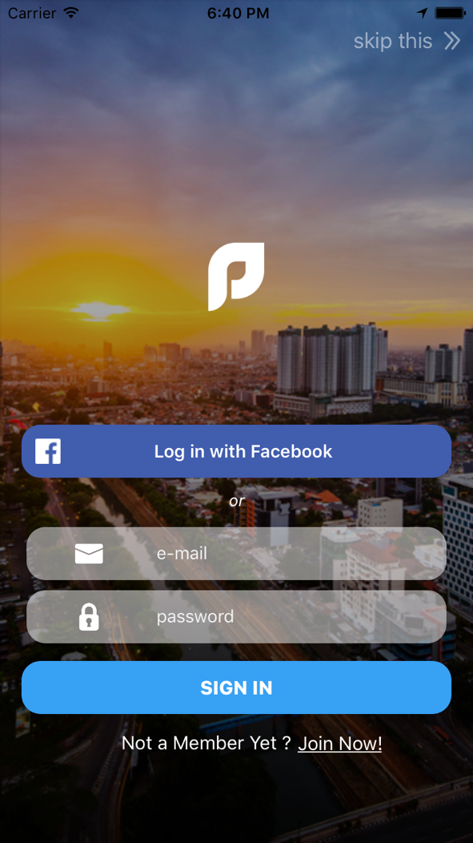
FACEBOOK API

Slide 4
AMAZON

Slide 5

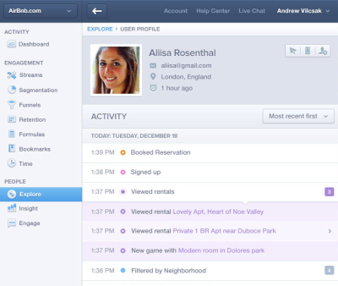
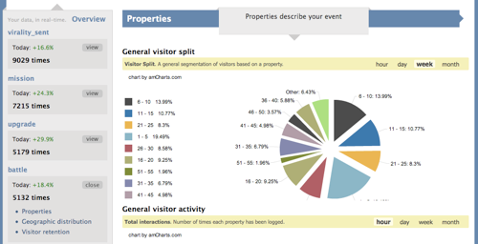
MIX PANEL

Slide 6

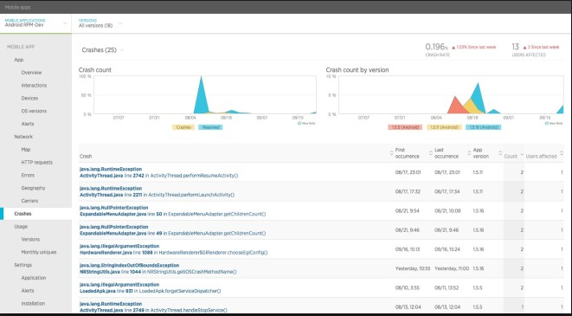
NEW RELIC

Slide 7
APPLICATION Demo

Slide 8
Q&A

